Slide 2
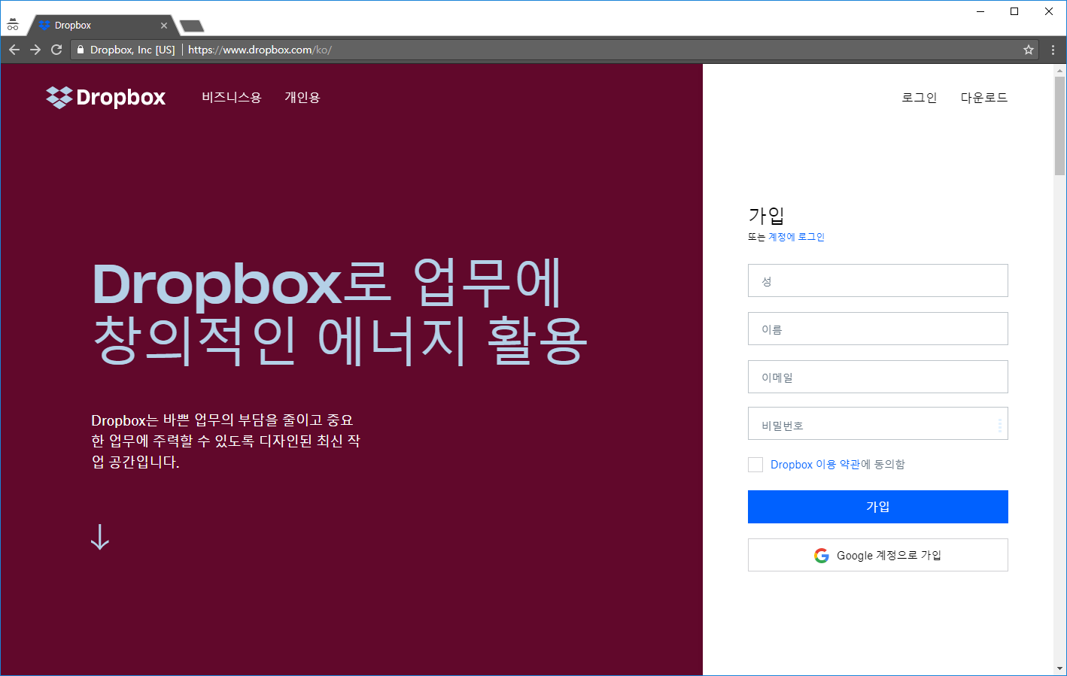
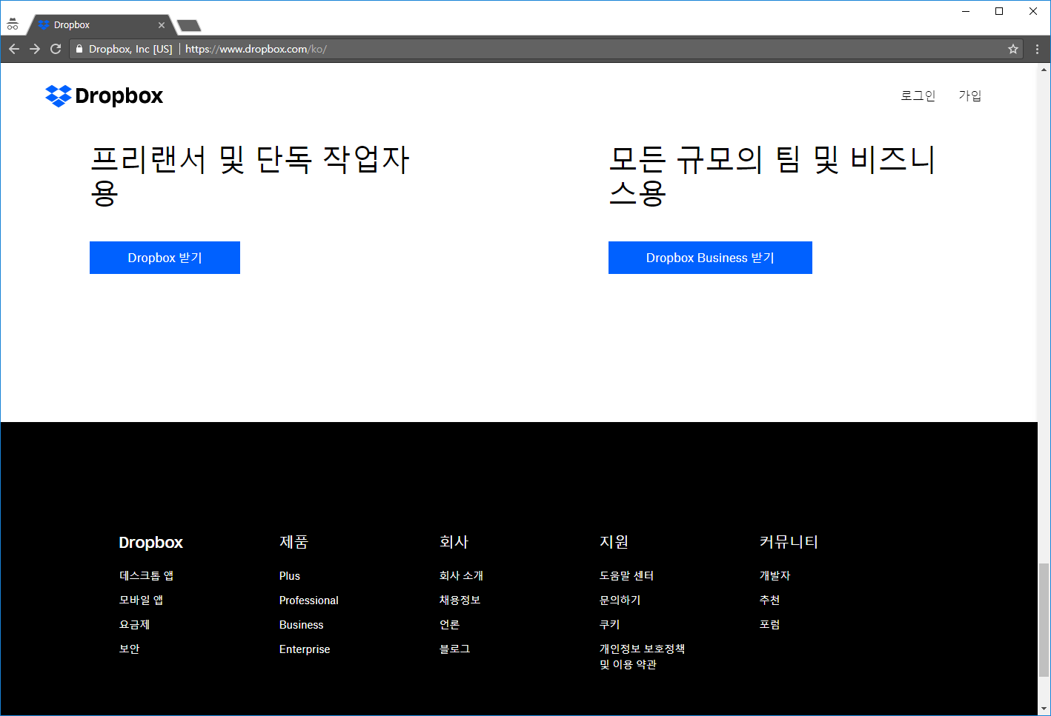
메인페이지 https://www.dropbox.com/ko/
CRUD
Create | O
Read | X
Update | O
Delete | X

Slide 3
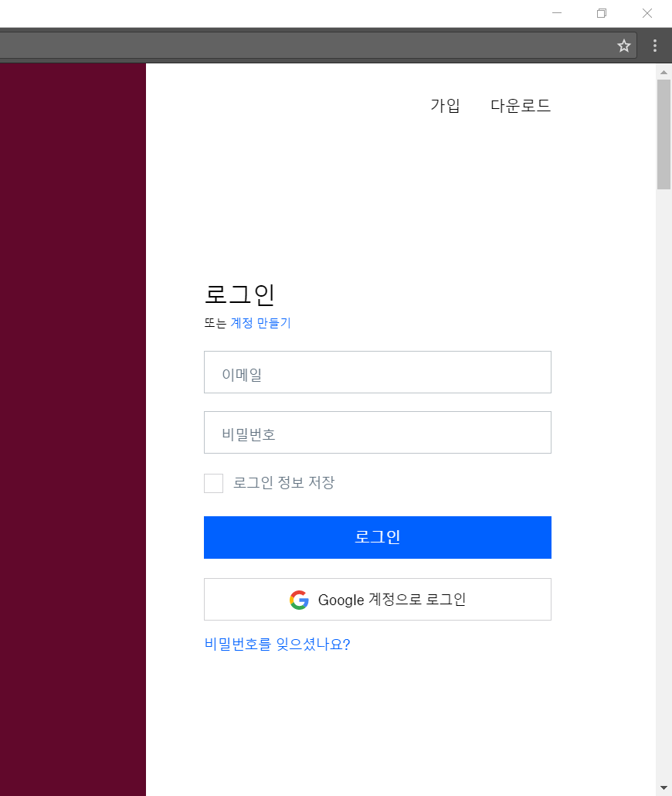
로그인 https://www.dropbox.com/ko/
CRUD
Create | O
Read | X
Update | O
Delete | X

Slide 4
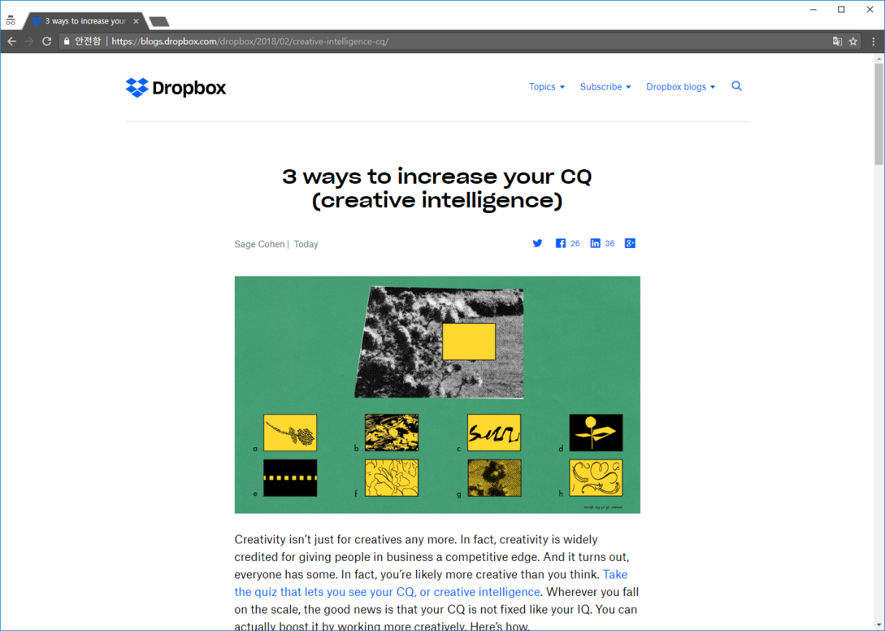
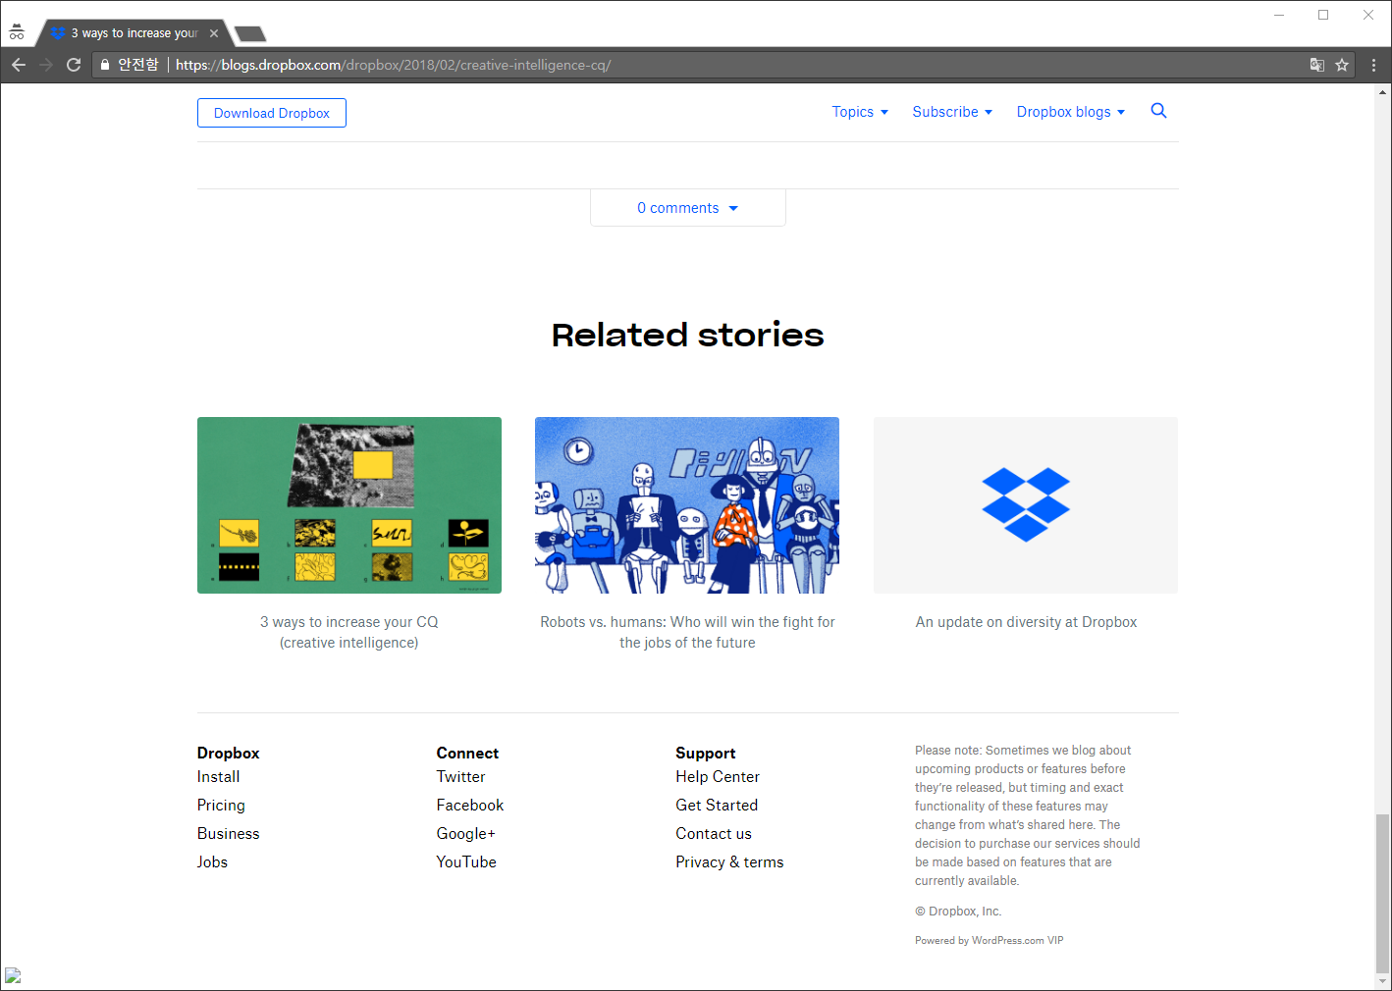
블로그 https://blogs.dropbox.com/dropbox/
CRUD
Create | O
Read | O
Update | O
Delete | O

Slide 5
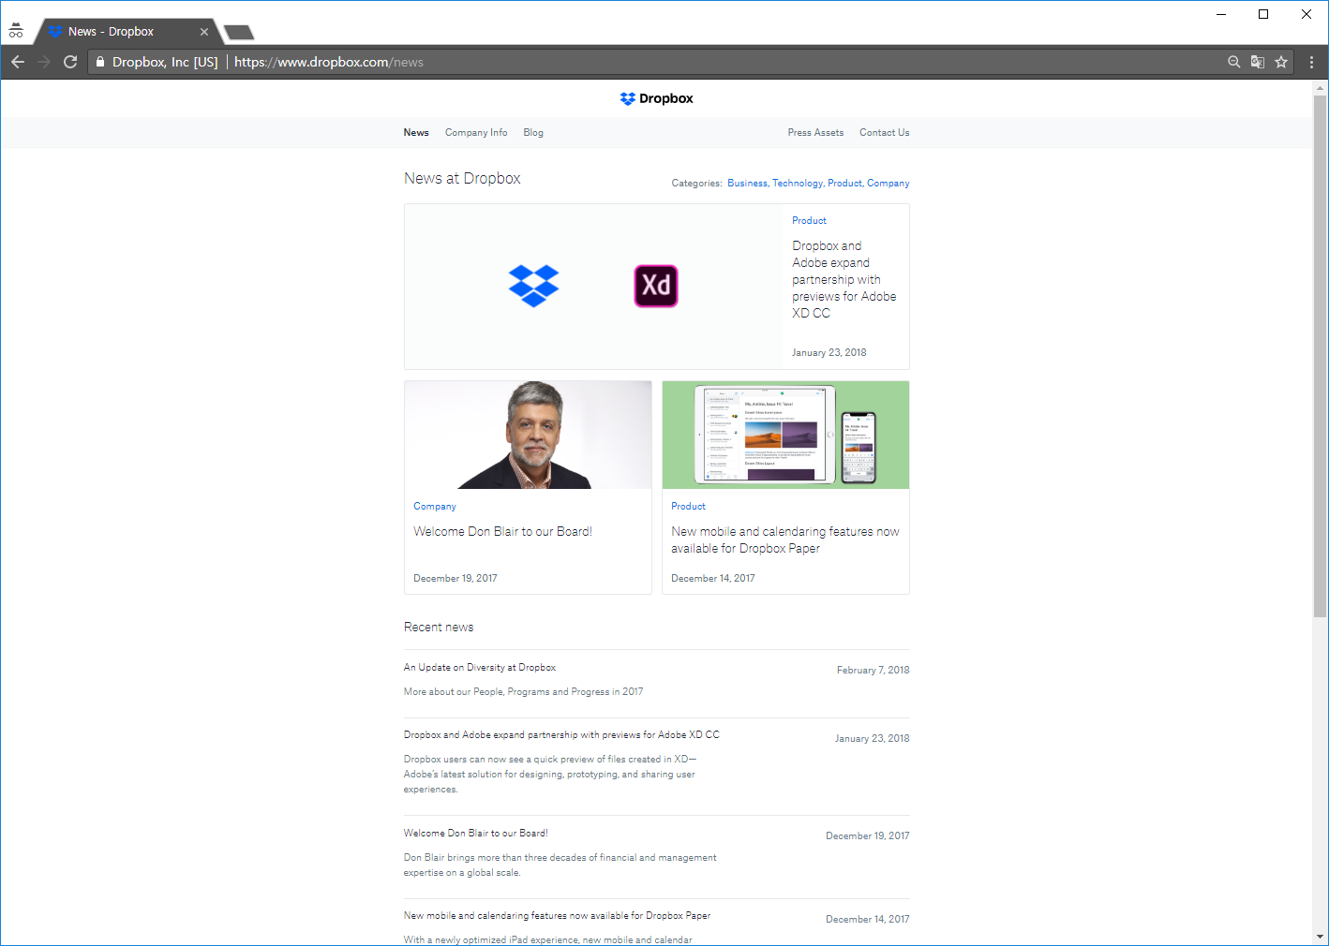
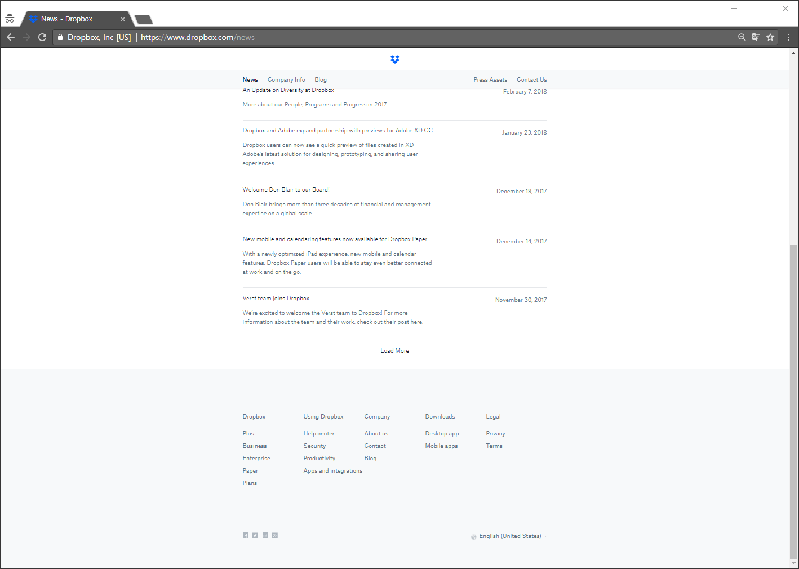
뉴스 https://www.dropbox.com/news
CRUD
Create | X
Read | O
Update | X
Delete | X

Slide 6
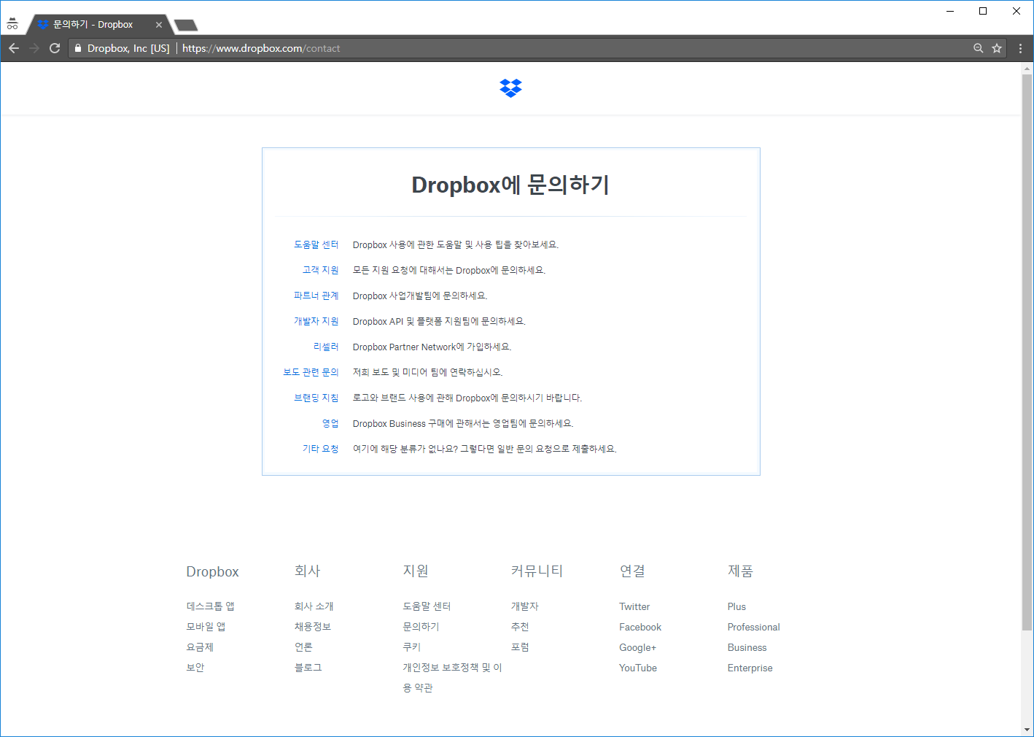
문의하기 https://www.dropbox.com/contact
CRUD
Create | X
Read | O
Update | X
Delete | X

Slide 7
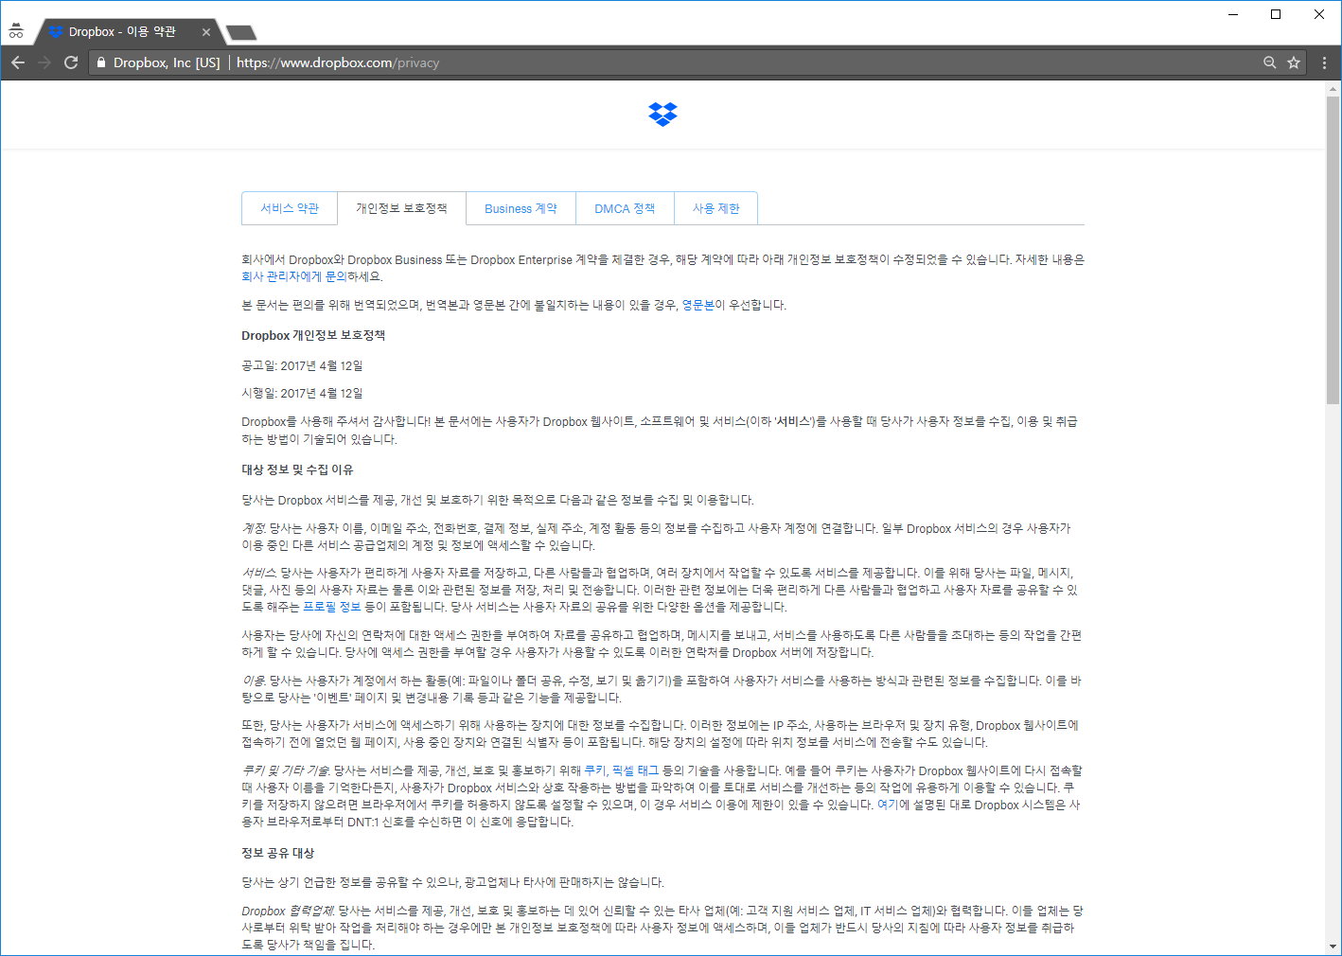
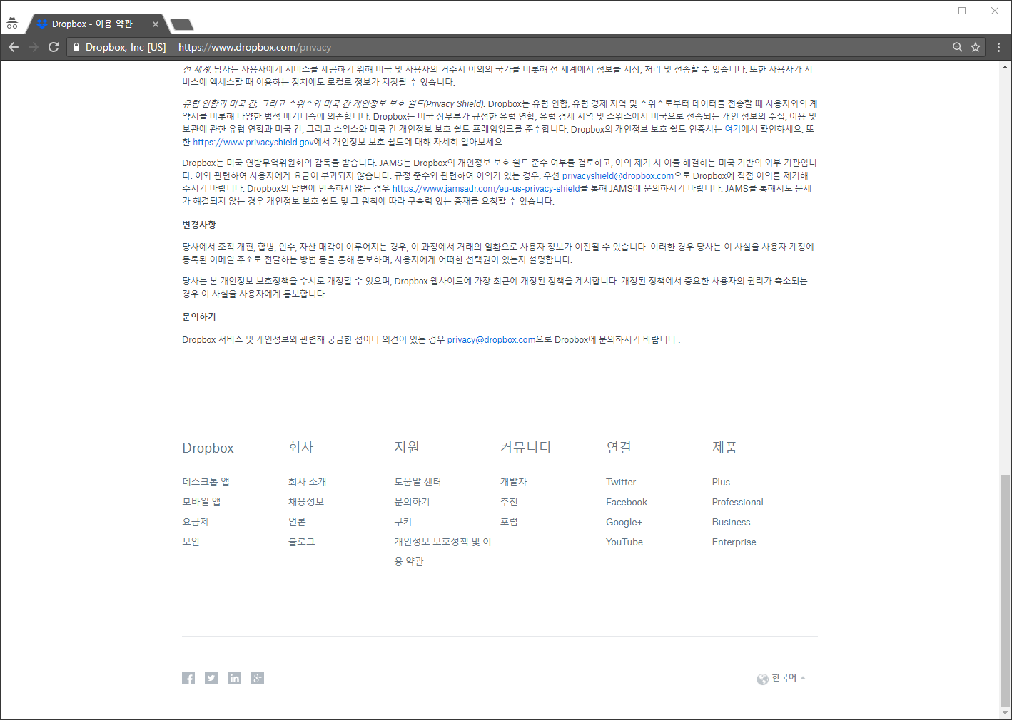
개인정보 정책 및 이용약관https://www.dropbox.com/privacy
CRUD
Create | X
Read | O
Update | X
Delete | X

Slide 8
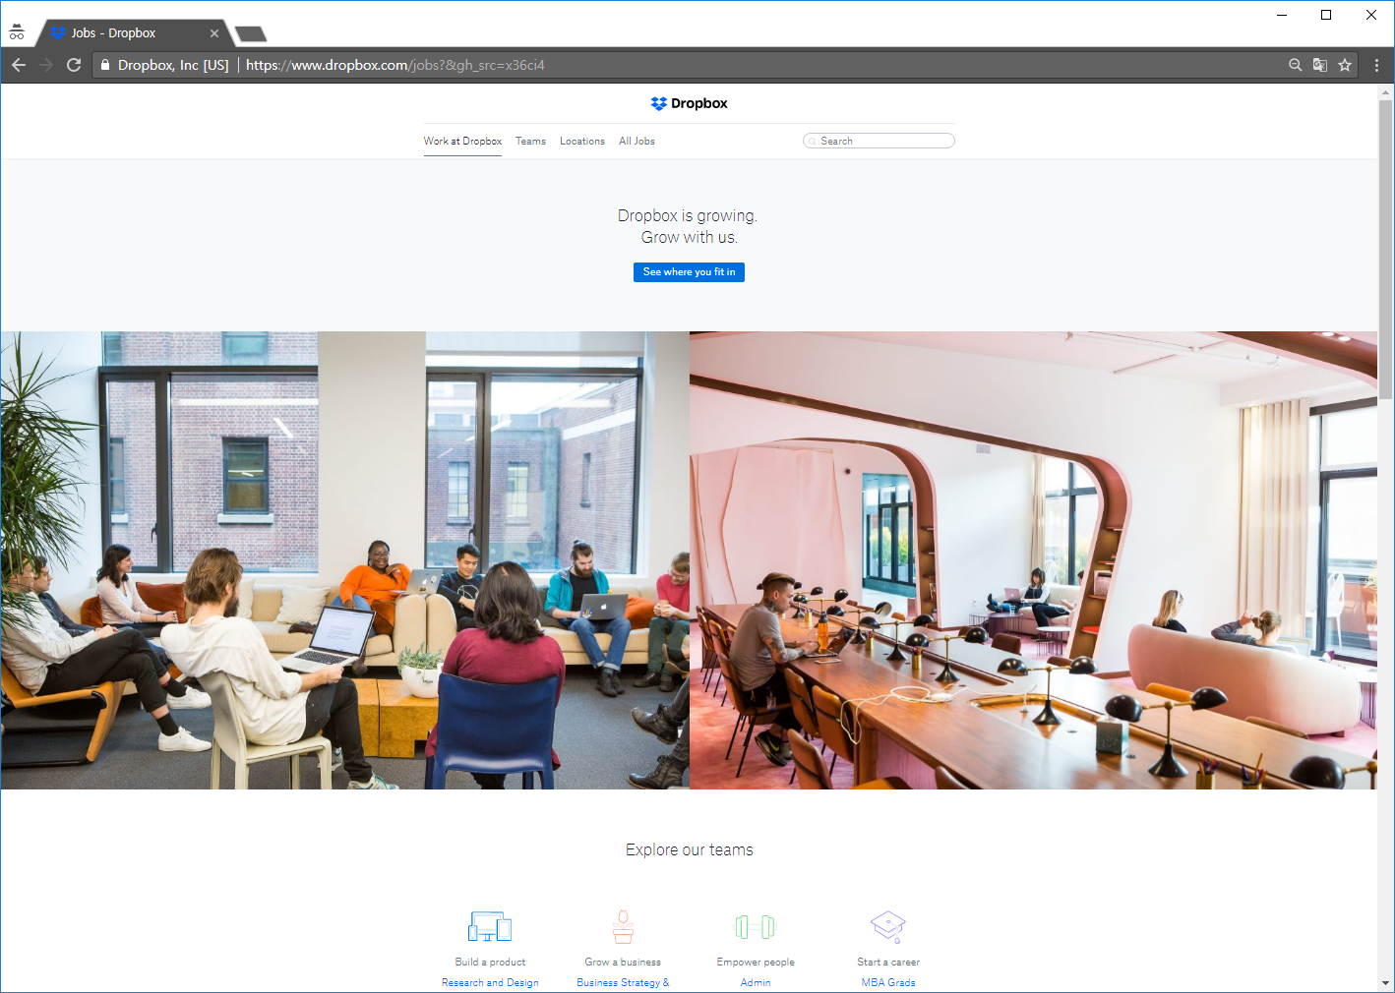
채용정보 https://www.dropbox.com/jobs?&gh_src=x36ci4
CRUD
Create | O
Read | O
Update | O
Delete | X

Slide 9
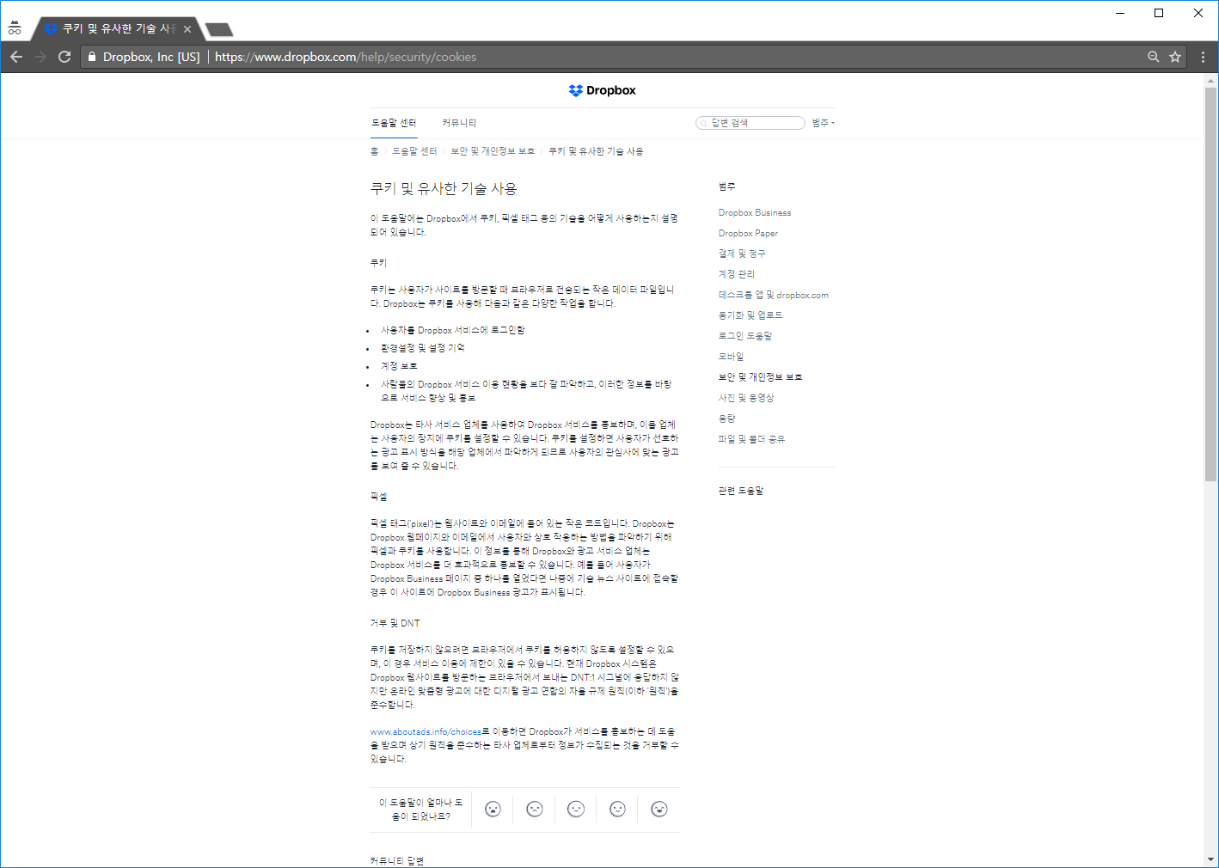
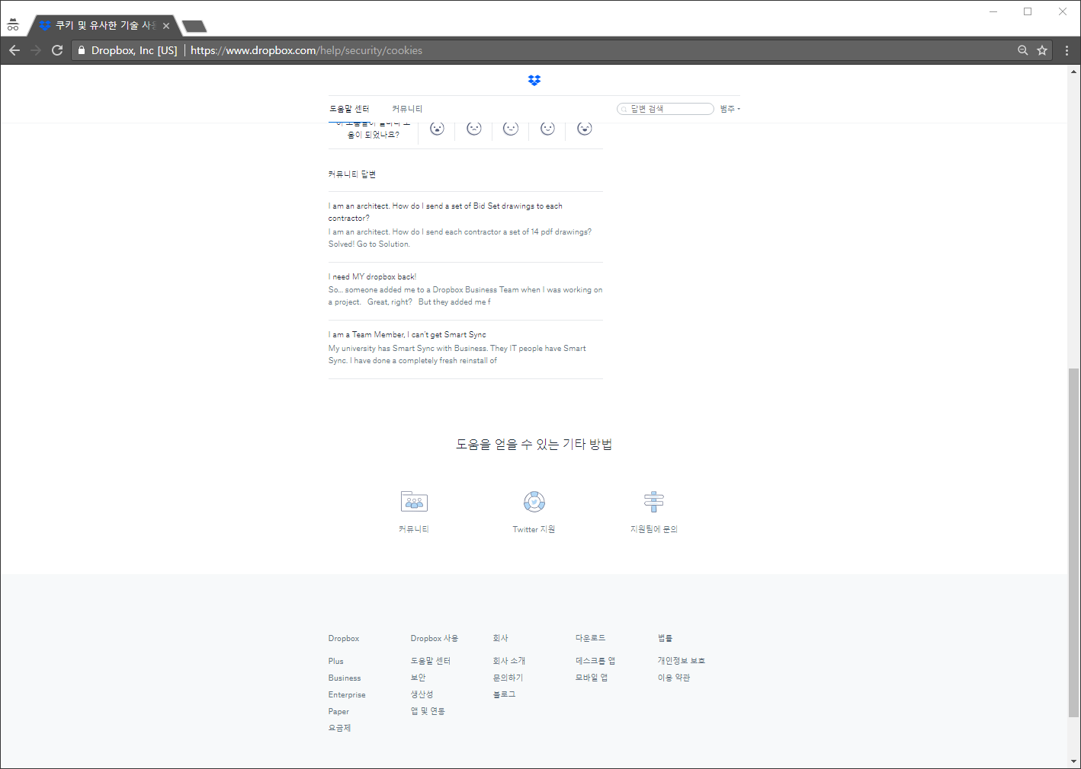
쿠키정책 페이지https://www.dropbox.com/help/security/cookies
CRUD
Create | X
Read | O
Update | X
Delete | X

Slide 10
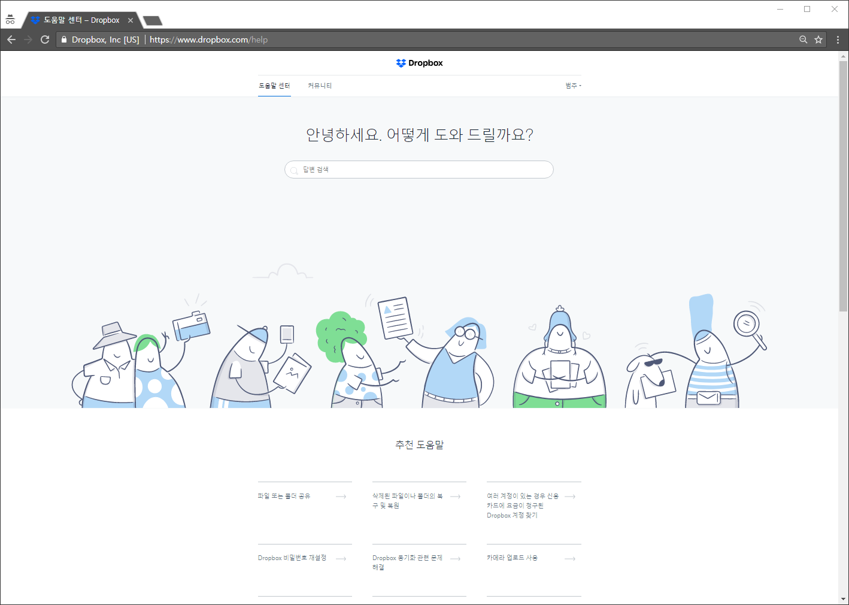
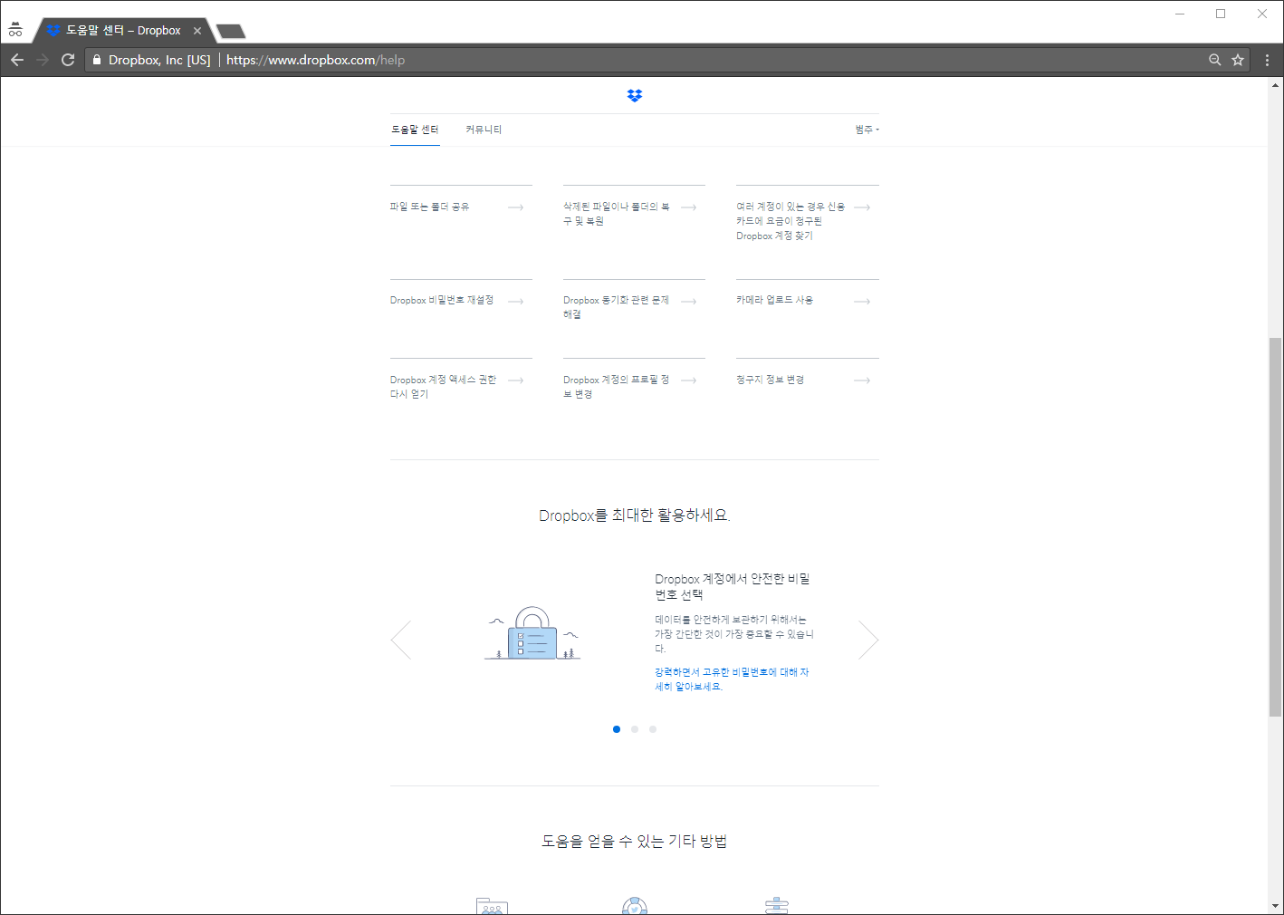
도움말 https://www.dropbox.com/help
CRUD
Create | O
Read | O
Update | X
Delete | X

Slide 11
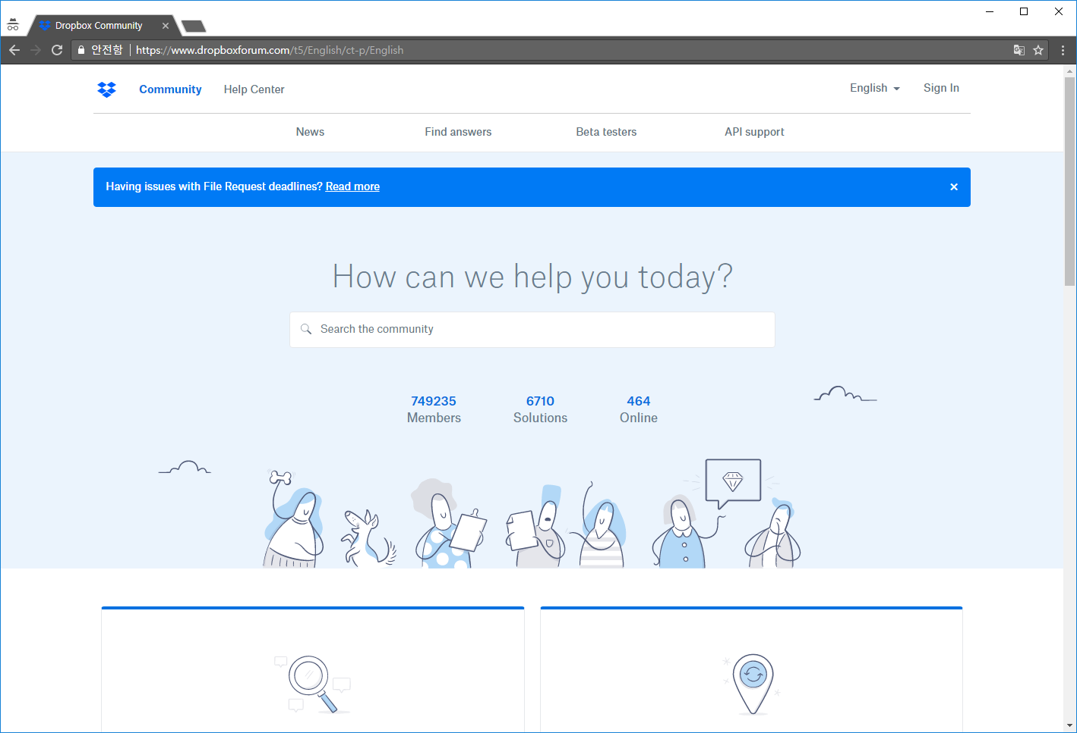
포럼 https://www.dropboxforum.com/t5/English/ct-p/English
CRUD
Create | O
Read | O
Update | O
Delete | X

Slide 12
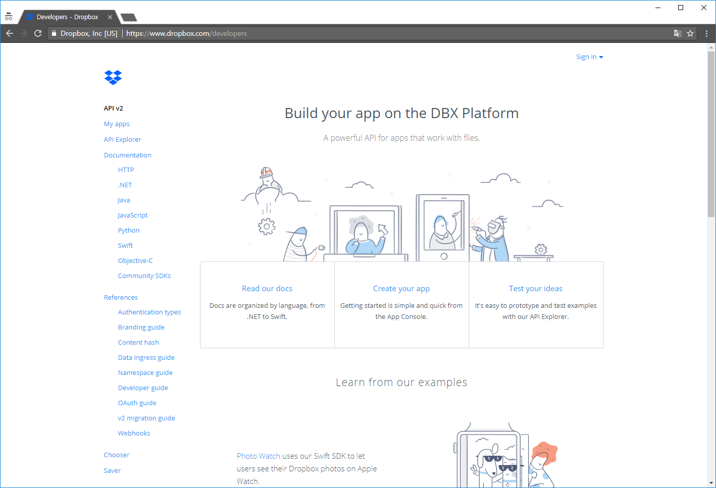
개발자 페이지 https://www.dropbox.com/developers
CRUD
Create | O
Read | O
Update | O
Delete | O

Slide 13
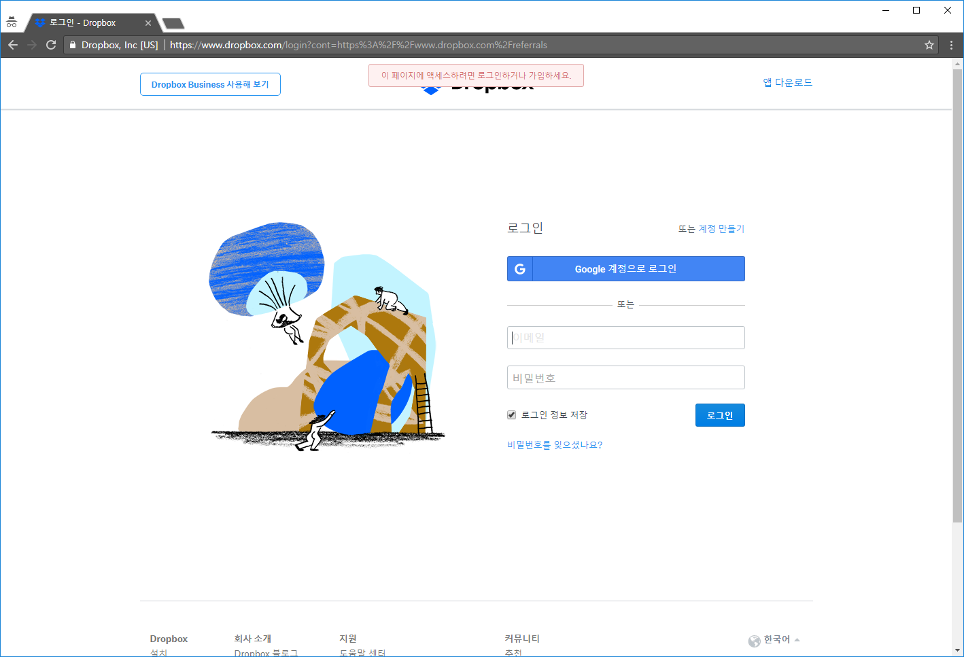
추천 https://www.dropbox.com/login?cont=https%3A%2F%2Fwww.dropbox.com%2Freferrals
CRUD
Create | X
Read | O
Update | X
Delete | X

Slide 14
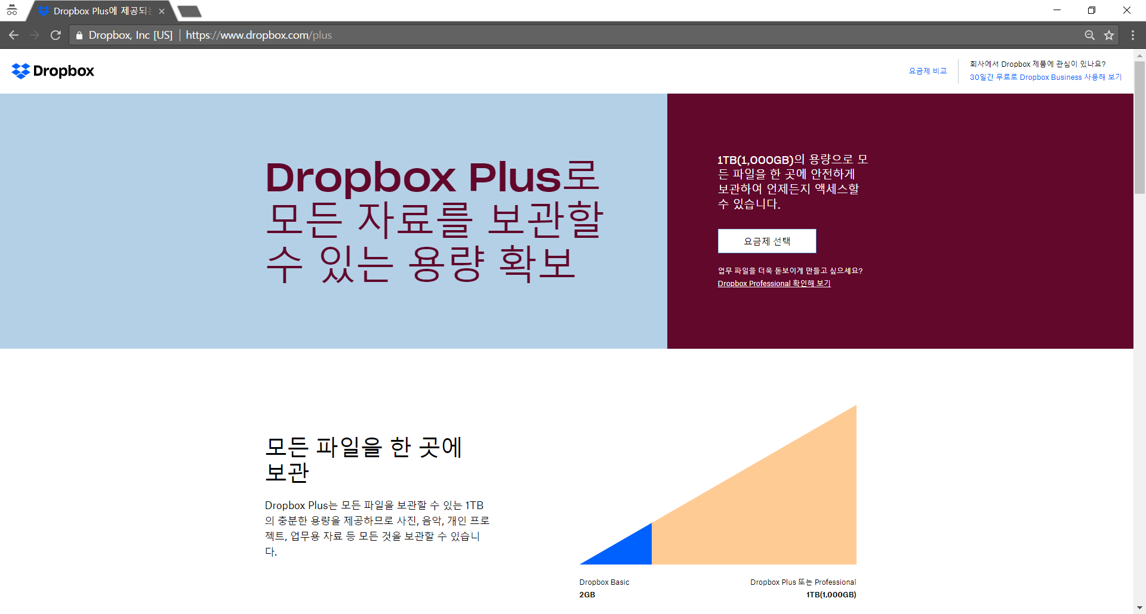
Dropbox plus https://www.dropbox.com/plus
CRUD
Create | X
Read | O
Update | X
Delete | X

Slide 15
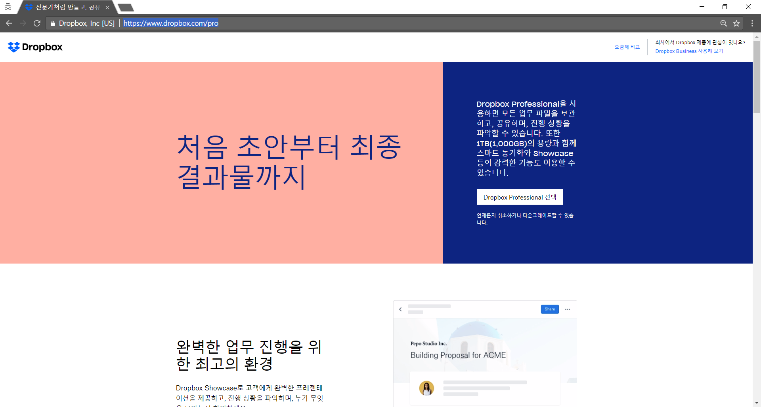
Dropbox pro https://www.dropbox.com/pro
CRUD
Create | X
Read | O
Update | X
Delete | X

Slide 16
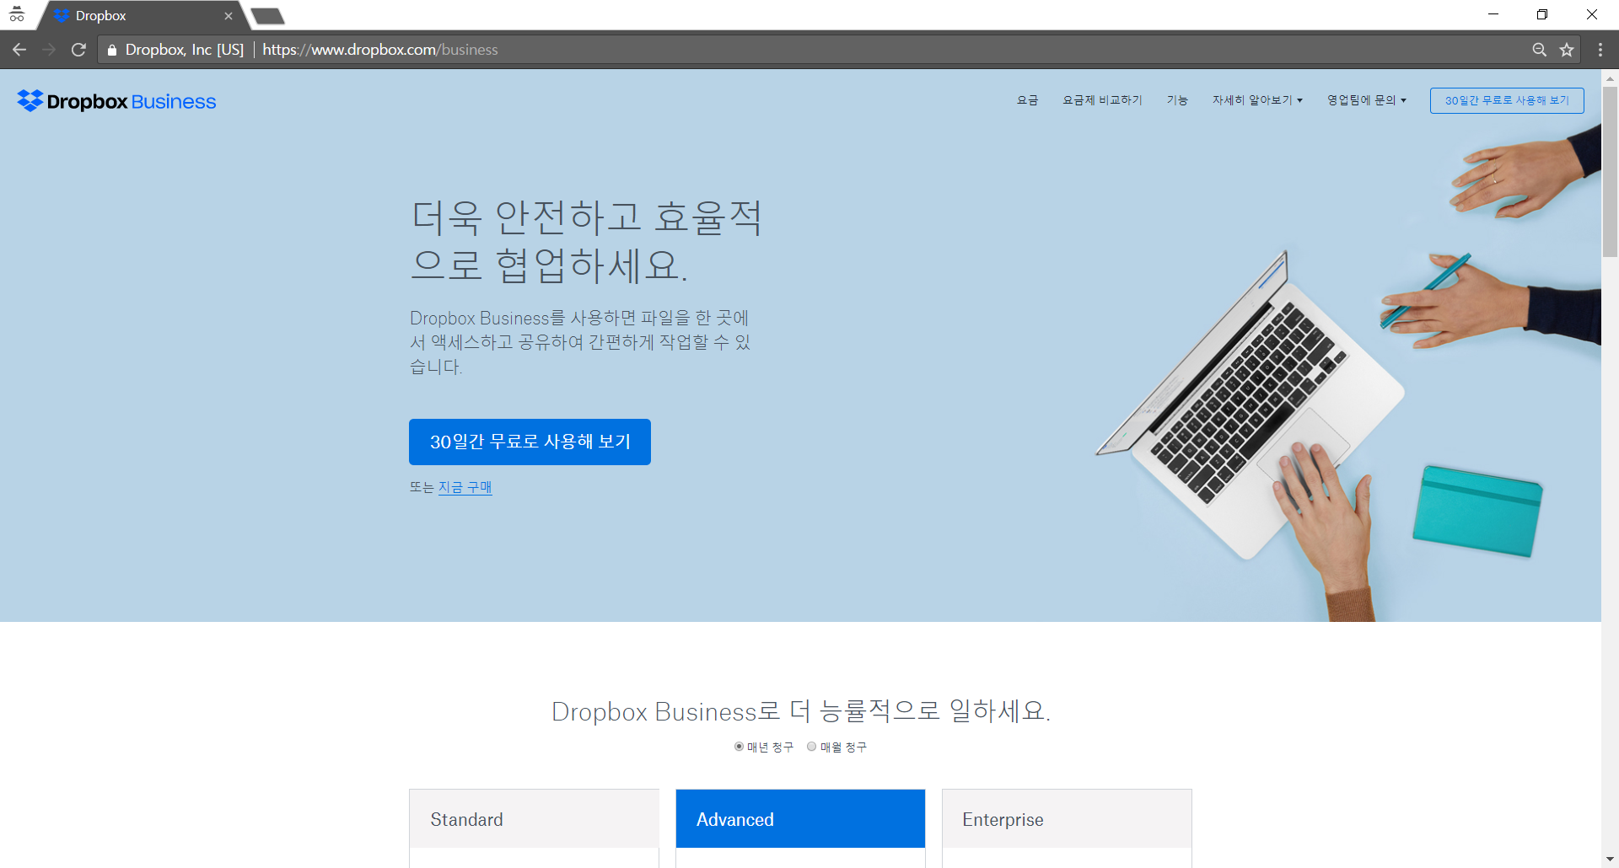
Dropbox business https://www.dropbox.com/business
CRUD
Create | X
Read | O
Update | X
Delete | X

Slide 17
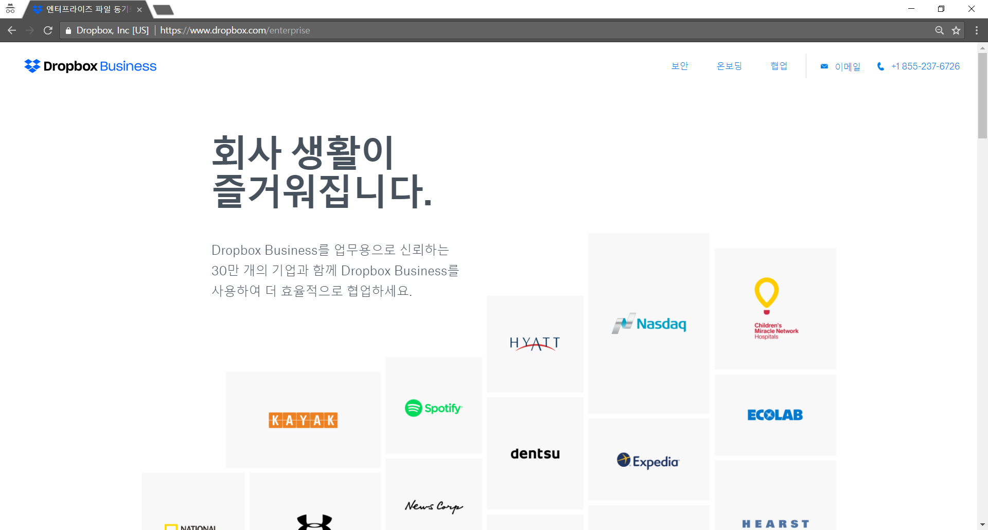
Dropbox enterprise https://www.dropbox.com/enterprise
CRUD
Create | X
Read | O
Update | X
Delete | X

Slide 18
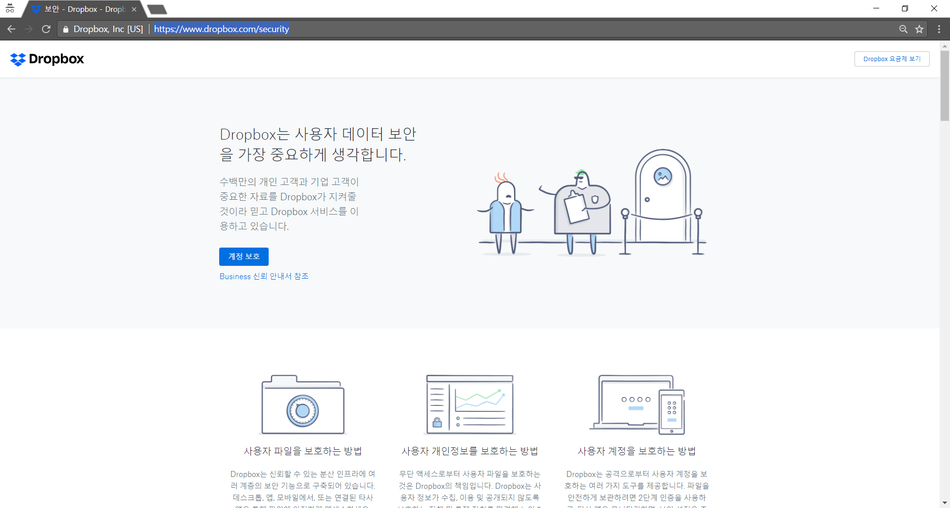
보안 https://www.dropbox.com/security
CRUD
Create | X
Read | O
Update | X
Delete | X

Slide 19
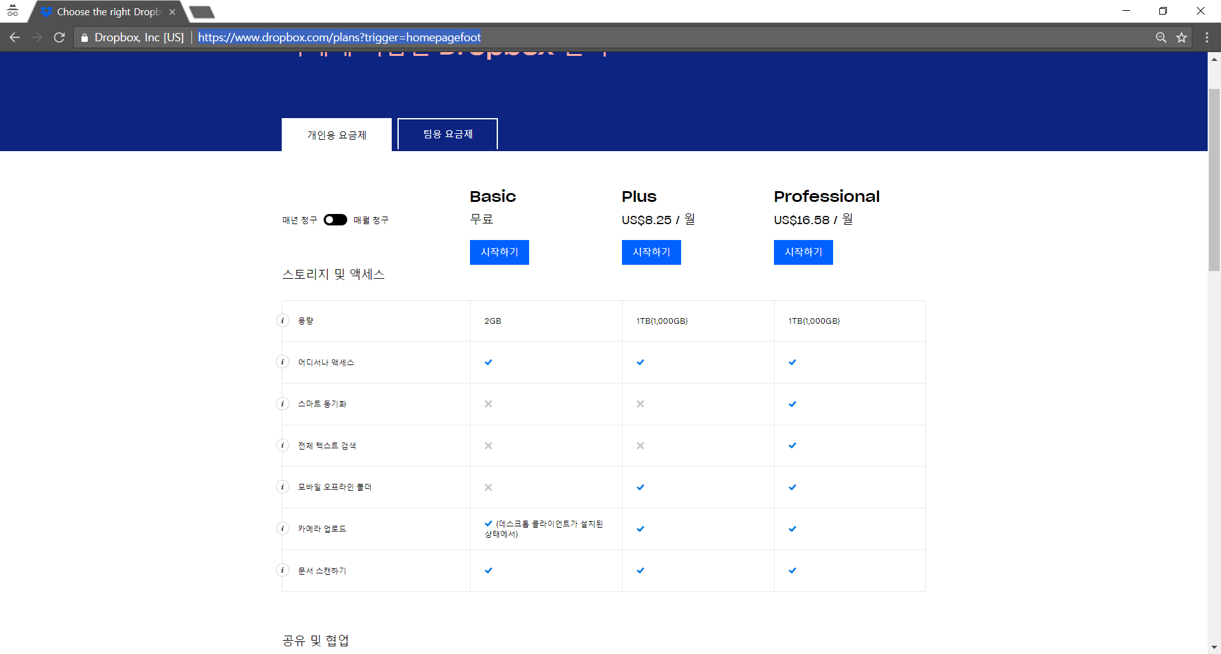
요금제 https://www.dropbox.com/plans?trigger=homepagefoot
CRUD
Create | X
Read | O
Update | X
Delete | X

Slide 20
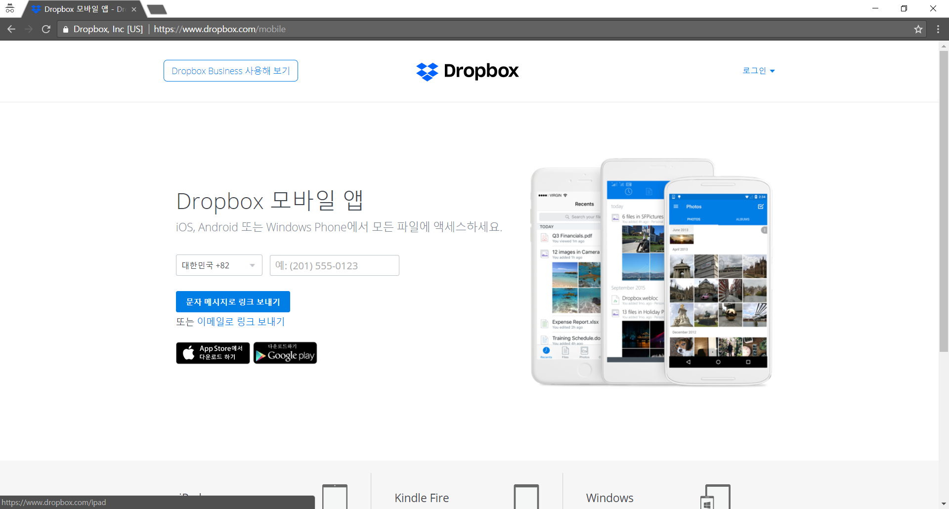
모바일 앱 https://www.dropbox.com/mobile
CRUD
Create | X
Read | O
Update | X
Delete | X

Slide 21
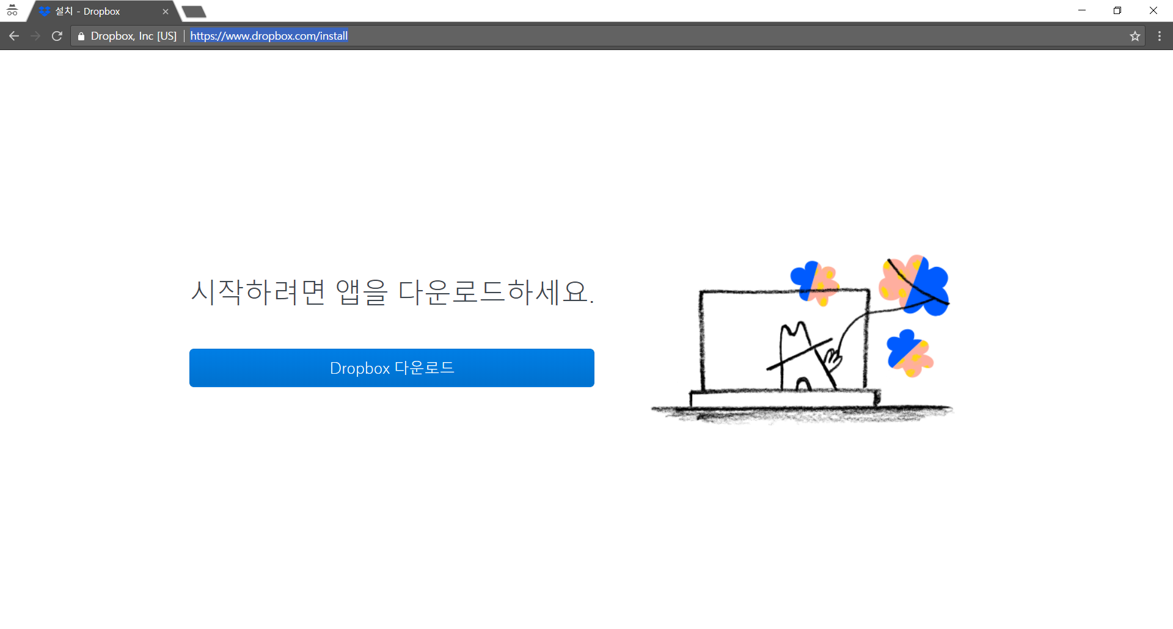
다운로드 https://www.dropbox.com/install
CRUD
Create | X
Read | O
Update | X
Delete | X

Slide 22
메인화면
다운로드
plus
모바일앱
요금제
요금제
pro
business
보안
enterprise
도움말
문의
쿠키
개인정보 이용약관
회사소개
채용정보
언론
블로그
개발자
추천
포럼

